Slide 1
Brandname leicht
PRODUCT ARGUMENTATION

Slide 2
Hinges with integrated cushioning
See price list page 11.01
For all kind of units
Cushioning ca be adjusted by three steps
Cushioned limit stay for standard and wide-angle hinges

Slide 3
Wall unit fixing: loading capacy 100 kg
See price list page 11.05

Slide 4
Drawers and pull outs
See price list page 11.02
Double walled welded steel frame

Slide 5
Drawers and pull outs
See price list page 11.02
AIRMATIC
Air-damped guide-rails

Slide 6
Drawers and pull outs
See price list page 11.02
Straight interior sides

Slide 7
Pull outs
See price list page 11.02
Attached glass sides

Slide 8
drawers
See price list page 22.13
Drawers in 2 different heights
e.g. below hobs

Slide 9
Height-adjustable swing-out shelves
See price list page 22.11

Slide 10
Inner drawers and inner pull outs
Actual width is equivalent to the nominal

Slide 11
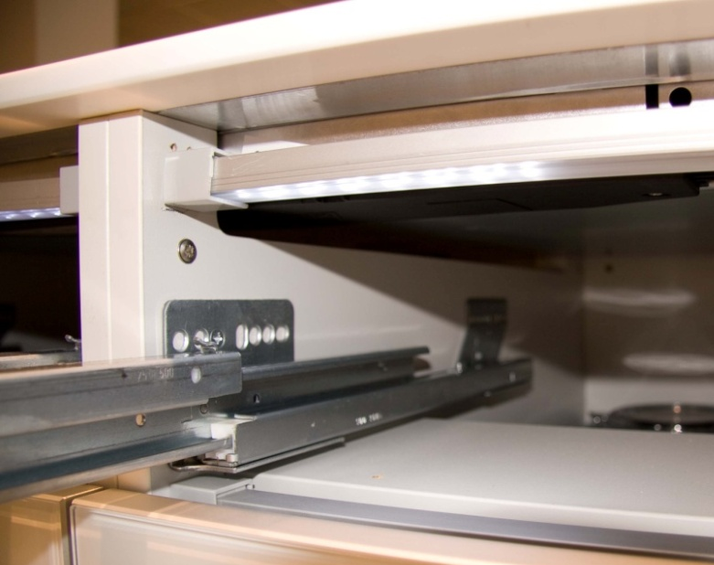
Hob solutations
See price list page 22.13
Coping of centre partition on units with above installed hob.

Slide 12
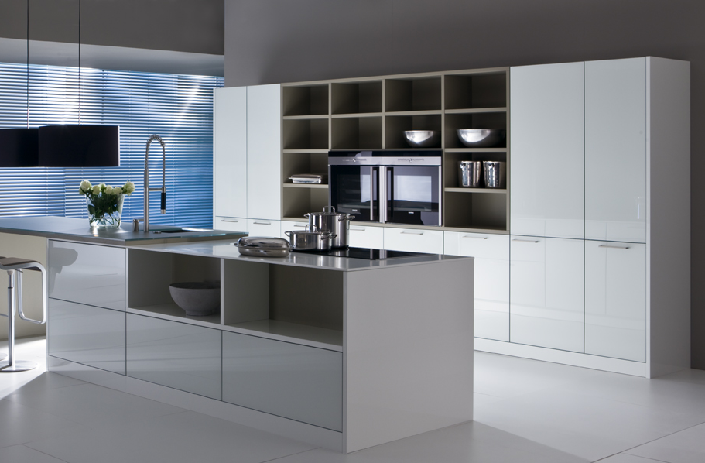
Plinth flush to front
See price list page 61.02

Slide 13
Plinth flush to front cut mitred
See price list page 61.02

Slide 14
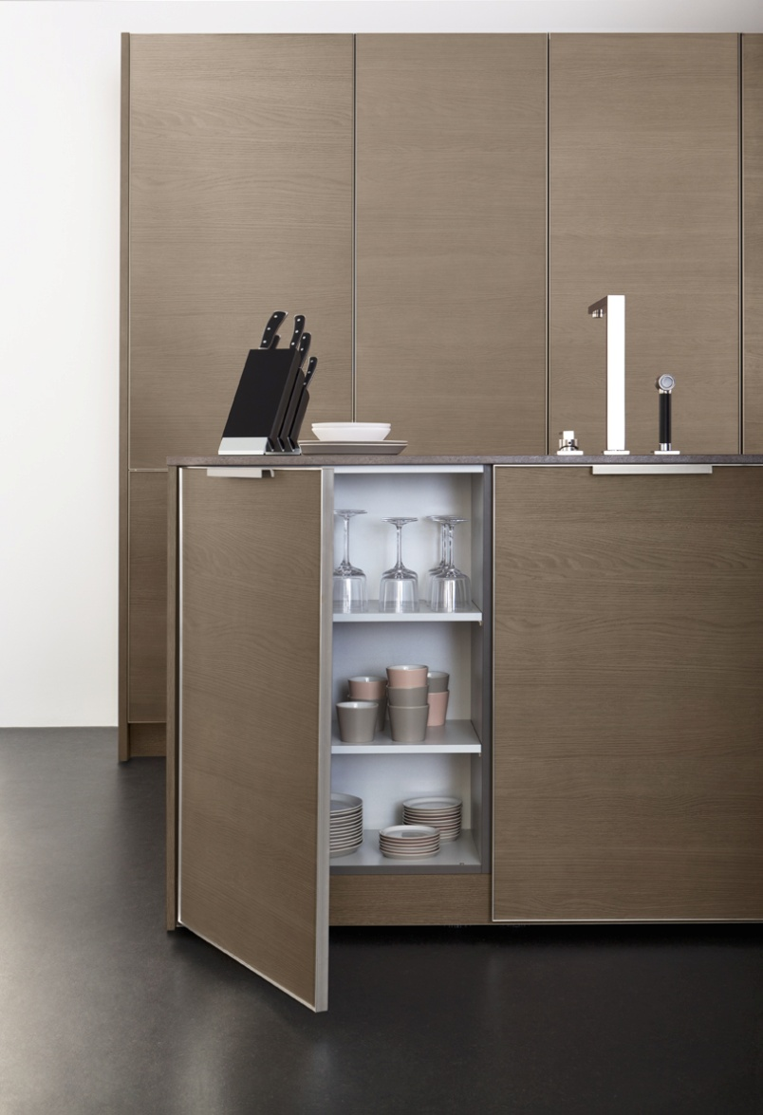
Extended height on doors
See price list page 24.05

Slide 15
Matching graining | image (ki, di, hi) as of pg 1
Also available on midway units

Slide 16
Storage units
Glass bottoms: standard on VZ units
Info: LEICHT uses only chrome-plated wire inserts, no powder coated material.

Slide 17
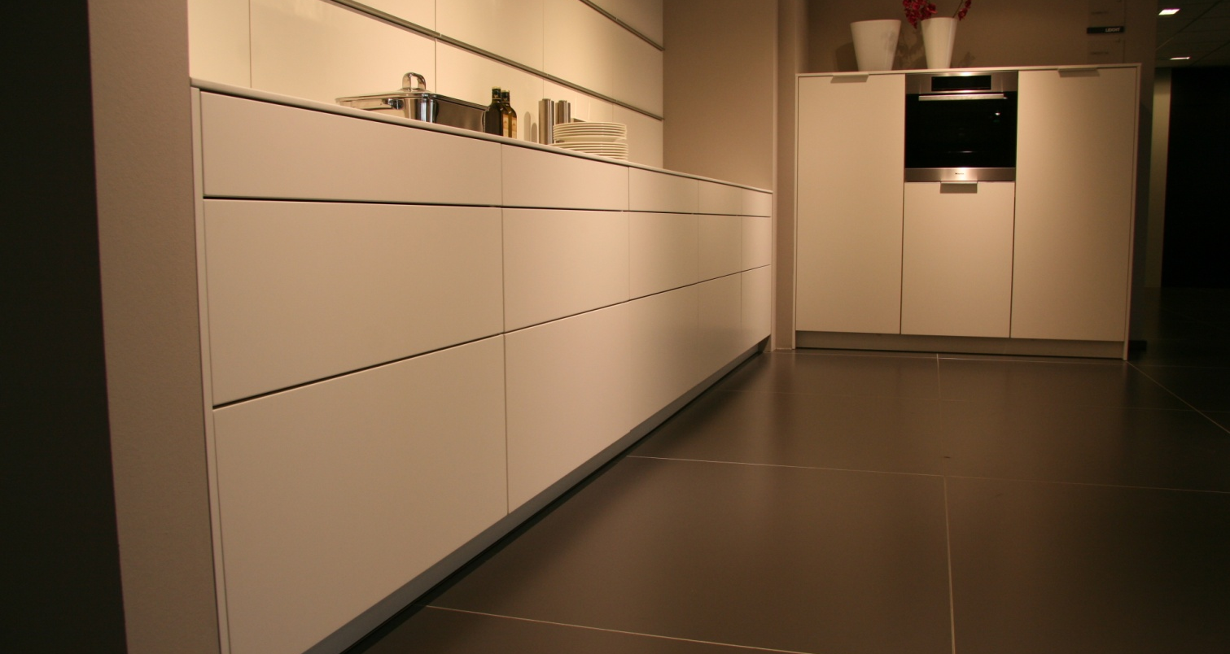
Joint gap 2,5 mm

Slide 18
Water-base coatings
More than 75% of the lacquer are on water- based technology.

Slide 19
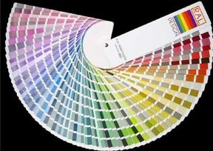
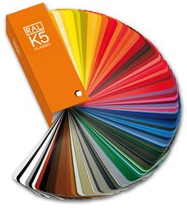
Special lacquering of coulour systems
RAL-Design
RAL-Classic
NCS
Per coulour and kitchen

Slide 20
Original edge finishes overpainted
See price list page 24.04
Individually dimensioned lacquered fronts are fitted with an edge with the same radius. This edge is overlacquered, thus to give the front the appearance of the original optic.

Slide 21
Modular housing units
See price list chapter 45
No blenders on housing units with smooth fornts.

Slide 22
One piece made fronts on tall units without extra costs

Slide 23
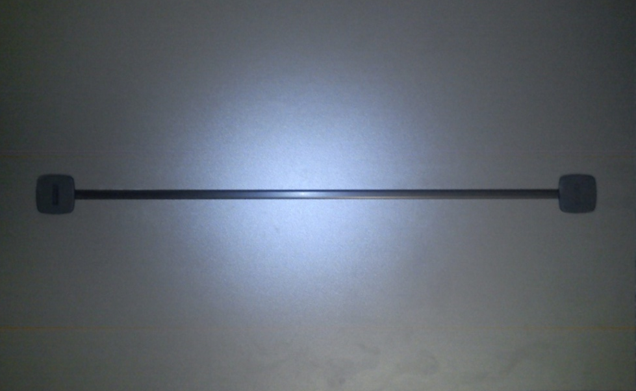
Fitting for adustment of the front
See price list page 45.19

Slide 24
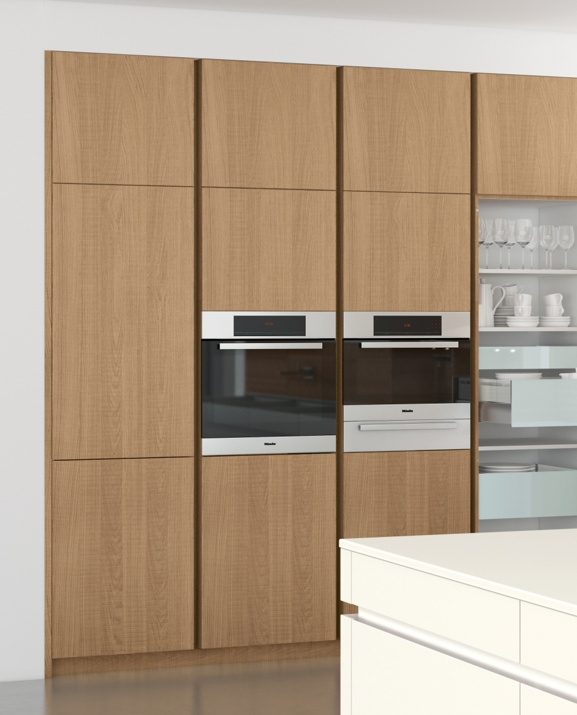
Vertical recessed grip
See price list page 13.09
Standard in aluminium or coulour lacquered (also RAL).

Slide 25
Support bracket for appliances
See price list page 45.16
For use between 2 appliances for optimising gaps (3mm).

Slide 26
Midway corner cupboard
See price list page 55.07
Can be variably used for width solutions.

Slide 27
Elevated dishwasher
See price list chapter 46
Variable height
Drip-tray
Sheet metal protector for edges
Backwards chamfered edge as to have a minimal joint gap (AVANCE-programmes)

Slide 28
Width alteration on pull outs
See price list page 24.05
Pull outs can be produced in 1cm increments.
Individual width alterations are fitted with back panel in carcase material.

Slide 29
Carcase side extra deep
See price list page 24.05
Also as extra deep visible side on
Floor units
Wall units
Tall units

Slide 30
Stengthening on thin worktops
See price list page 24.06
In case of use of existing worktops it is possible to order strengthenings for cupboards (extra costs).

Slide 31
Vario-top
See price list page 58.05

Slide 32
Suspended floor units
See price list chapter 95

Slide 33
Slide-away doors tall units

Slide 34
Washing maschine housing

Slide 35
Cookware-centre

Slide 36
Side panel shelf units
See price list page 94.03

Slide 37
lighting
Uniform lighting concept with consistent coulour of light.
For the use in different plannings.

Slide 38
lighting
See price list page 72.01
Integrated in bottom shelves.

Slide 39
lighting
See price list page 72.01
Integrated in wall units.

Slide 40
lighting
See price list page 72.02
For fitting on individual placement.

Slide 41
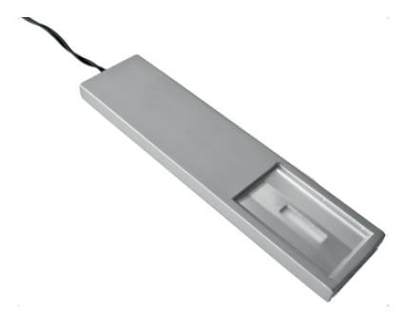
lighting
See price list page 72.02
Mounted LED lamp for individual placement.

